Slide 1
Pattern-of-life Analysis and Deviations for Bluetooth and
Bluetooth Low Energy Devices
Alexander Armstrong, Seth Bedford, Troy Frazier, Vishal Madipadga, James Wei, Evelyn Wong

Slide 2
Outline
Introduction and Motivation
Goals
Approach
  Ubertooth One Capture
  Identifying Packets
Issues Encountered
Solutions

Slide 3


Introduction and Motivation
IOT has exploded in the last decade
Billions of devices now connected to the internet
Little to no security considerations are taken
Opens the opportunity for malicious actors to gain unauthorized access to a system through bluetooth devices
Aim to monitor and detect abnormal bluetooth behavior
Notes:
Example: Majority of bluetooth communication is done in plaintext

Slide 4
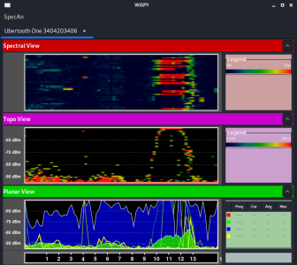
Goals
Capture and analyze bluetooth packets to develop a pattern of life of bluetooth devices
Use gathered data to model whether a device is behaving normally or abnormally
Determine if a bluetooth device is acting maliciously based on the developed model
Machine learning models provide a promising strategy for creating a standard model of normal behavior
Example of a visual graph of network traffic we captured

Slide 5
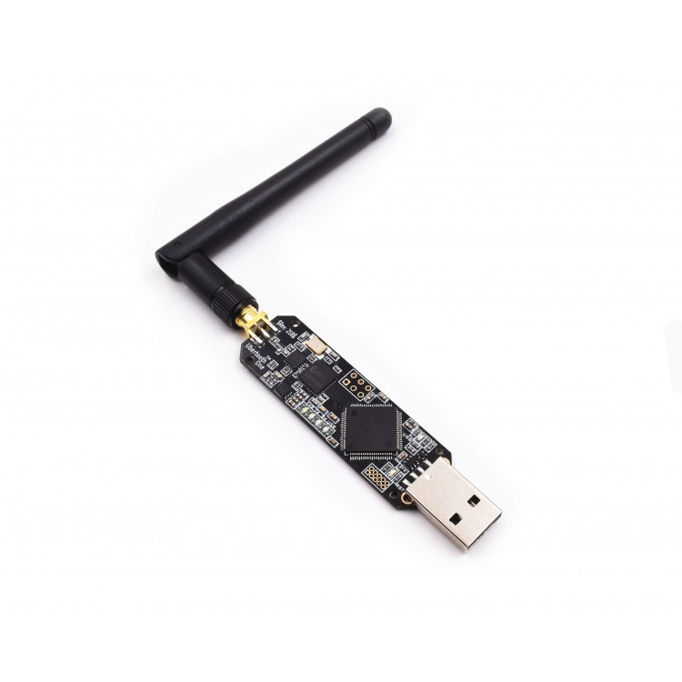
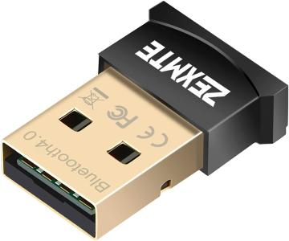
Approach - Capturing Packets
We set up a Linux VM for capturing wireless communications and used an Ubertooth One to begin sniffing packets. A small bluetooth receiver like shown below is also needed.
Our team purchased 3 different bluetooth devices and began to record the data transferred when connected to the devices
Devices used are as follows:
Samsung galaxy smartwatch
Samsung wireless headphones
Fitbit
Notes:
An Ubertooth one needs a bluetooth receiver to function
The Ubertooth can capture on a 2.4 GHz antenna
Total cost of all components around $150, a small cost for malicious users!

Slide 6
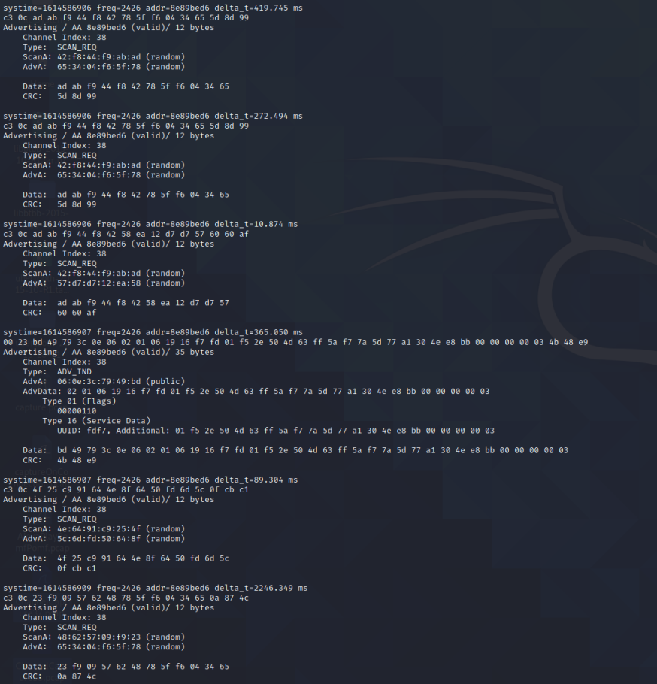
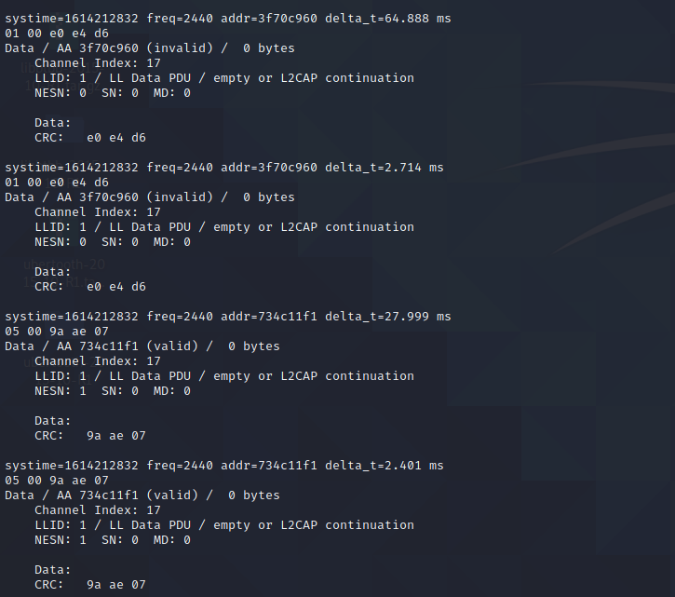
Example of Captured Traffic
Notes:
Here is an example of bluetooth traffic we were able to capture. On the left we have data packets and on the right we have advertising packets.

Slide 7
Approach - Identifying Packets
In the bluetooth protocol, advertising packets are used to identify a device
ADV_IND - a peripheral device requesting connection to a central device (ie: speakers to a phone)
ADV_DIRECT_IND - similar to above but directed to a specific central device (ie: wireless headphones to my phone)
ADV_NONCONN_IND - non connectable devices simply broadcasting
ADV_SCAN_IND - similar to ADV_NONCONN_IND but with more information upon scan request
ATT packets contain a GATT (Generic Attribute Profile) for a device
These store information about certain services and characteristics provided by a device
Notes:
One of our approaches is to identify packets that can help us establish a pattern-of-life for a particular bluetooth device. Put another way, extract features from certain packets that will allow us to uniquely identify a device.
Many of the packets we saw were advertising packets. There were 4 types of advertising packets we observed:
Advertising Indications Packets: These are packets where a peripheral device requests a connection to any central device in the area (an example of a peripheral device would be a smart watch or speakers. An example of a central device is your smartphone)
Advertising Direct Indications Packets: There are packets where a peripheral devices requests a connection to a specific central device
Advertising Nonconn indications: There are advertising packets that non-connectable devices broadcast to any listening devices
Advertising Scan Indications

Slide 8

Notes:
Packet identifiers such as type of advertising packet and channel shown outlined in red along with the bytes captured

Slide 9
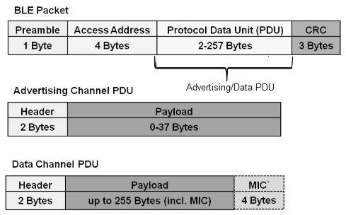
Issues Encountered
Difficulty in capturing the correct identifying packets, specifically ATT packets
Some devices send advertising packets, some only send on first connection, others will never send
Reasonable to assume a malicious actor may not send advertising packets or only send altered packets

Slide 10
Some Ideas
Since majority of bluetooth traffic is in plaintext, build a database of all traffic received and flag new traffic
Use Packet Density as a way of identifying malicious agents
Identify Services (and their associated characteristics) in a device’s GATT that can uniquely identify the device
Device-specific characteristics can serve as additional features beyond the generalized ones
Log characteristic stats over a period of time to establish pattern of life
  Device’s current operation will be compared to this general data
Notes:
2. Malicious agents launching an attack will send lots of traffic at once causing a spike compared to local traffic
3. Helps identify device type and what it’s doing
4. Knowing what the device does, we can identify more characteristics (device is earbuds -- majority of traffic should be continuous streams of music. Does it look like that? Device is a fitbit -- should not be transmitting large quantities of data for continuous periods. Does it look like that? etc)
5. Having identified these features, we can store the events in a database on a day-by-day basis and take the average over a period of time. If a device usually transmits X packets per day but transmits 3X, it should be flagged

Slide 11

Questions?

